Slide 1
Quiz on Lecture 12
Please receive the quiz handout from Cyrille, Oliver, Vincent, Jan
Complete the quiz in silence
Hand the quiz back

Slide 2
Quiz on Lecture 12
What are tokens in the context of LLMs:
  Full words
  Parts of words
  Single letters/numbers or punctuation
  All/any of the above
When operating with word embeddings, you can add or subtract the embedding vectors from one another. If you calculate Nairobi-Kenya+Japan, you are most likely to get the embedding for which word?
  Tokyo
  Paris
  Abuja
  Japan
Which option is NOT considered a good prompting best practice?
  Role assignment
  Few-shot learning
  Chain of thought
  Vague instructions
  Delimiters
Why is using structured output better than asking the model to give a certain structure using only a prompt:
  Using structured output is faster because the model doesn't need to think
  Structured output improves the model's creativity and imagination
  When using only the prompt, the model may still give an inaccurate structure or add additional text, but using structured output forces the model to output the correct structure.
  Structured output can read the user's mind better than prompts
What is the one thing you need to add to your code to make a fully functional chatbot which is aware of the conversation context and does not forget what you talked about?
  Function calling
  Structured output
  Conversation history
  Arms and legs

Slide 3
Quiz on Lecture 12
What are tokens in the context of LLMs:
  Full words
  Parts of words
  Single letters/numbers or punctuation
  All/any of the above
When operating with word embeddings, you can add or subtract the embedding vectors from one another. If you calculate Nairobi-Kenya+Japan, you are most likely to get the embedding for which word?
  Tokyo
  Paris
  Abuja
  Japan
Which option is NOT considered a good prompting best practice?
  Role assignment
  Few-shot learning
  Chain of thought
  Vague instructions
  Delimiters
Why is using structured output better than asking the model to give a certain structure using only a prompt:
  Using structured output is faster because the model doesn't need to think
  Structured output improves the model's creativity and imagination
  When using only the prompt, the model may still give an inaccurate structure or add additional text, but using structured output forces the model to output the correct structure.
  Structured output can read the user's mind better than prompts
What is the one thing you need to add to your code to make a fully functional chatbot which is aware of the conversation context and does not forget what you talked about earlier?
  Function calling
  Structured output
  Conversation history
  Arms and legs

Slide 4
Designing and Deploying
end-to-end
Production Grade ML Applications
Lecture 13: AI Agents
October 2025
Jan Ravnik & Oliver Angélil

Slide 5
Contents of three AI Agents Lectures:
Lecture 12: Fundamentals of LLMs and Basic Chatbot Construction
  Introduction to LLMs: History, architecture and training
  API calls and text completions
  Prompt engineering techniques
  Structured output and function calling
Lecture 13: Advanced Techniques with LangChain and React Agents
  What is agentic AI?
  LangChain modules for app development
  React agents, reasoning and decision-making
  Stateful agents
Lecture 14: Complex Systems and Swarm Intelligence
  Explore LangGraph for multi-agent systems
  Swarm intelligence principles and applications
  AI challenges in collective behavior
this lecture

Slide 6

What is Agentic AI
Autonomous software systems that can:
Perceive their environment
Make decisions based on goals
Take actions independently
Learn and adapt over time
They are:
Built with a reasoning engine (typically an LLM)
Enhanced with tools (APIs, search, databases)
Can maintain memory across interactions
Agentic AI
Tools
(function calls, APIs, databases…
LLM
Question
Answer
Orchestrator
Other (Agentic) AI system(s)

Slide 7
Why is Agentic AI Useful?
Overcome limitations of static AI systems
Solve complex problems by breaking them into steps
Connect multiple systems and data sources
Perform sequences of actions without human intervention
Adapt to new situations using reasoning abilities
Deliver more personalized and contextual assistance
Agentic AI
Tools
(function calls, APIs, databases…
LLM
Question
Answer
Orchestrator
Other (Agentic) AI system(s)

Slide 8
Agentic AI patterns
Reflection
  Let the system think about its output and reflect on it
Tool use
  Use of various tools to gather information
  We did this yesterday
Planning
  Give answer in multiple steps - start by planning how the answer should look like and then improve (iterate on it).
  Much like what a human does - you don’t write a full essay from scratch
Multi-agent collaboration
  Use different LLMs with different assigned roles

Slide 9
LangChain and React Agents
Today's focus:
LangChain framework components for application development
React agents: Reasoning, Acting, and Thinking
Building stateful agents that maintain context
Practical implementation patterns and examples
Learning goals: Understand how to build advanced AI applications that can reason and make decisions

Slide 10
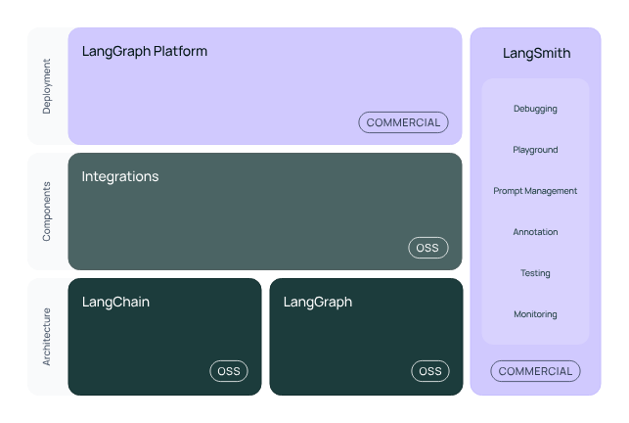
LangChain: What is it?
LangChain simplifies every stage of the LLM application lifecycle:
Development: Build your applications using LangChain's open-source components and third-party integrations. Use LangGraph to build stateful agents with first-class streaming and human-in-the-loop support.
Productionization: Use LangSmith to inspect, monitor and evaluate your applications, so that you can continuously optimize and deploy with confidence.
Deployment: Turn your LangGraph applications into production-ready APIs and Assistants with LangGraph Platform.

Slide 11
LangChain: A Framework for LLM Applications
LangChain provides modular components for building LLM applications:
Core components:
Models: Interface with various LLMs (OpenAI, Anthropic, local models)
Prompts: Template management and prompt engineering
Output Parsers: Structure LLM outputs into usable formats
Memory: Maintain conversation history and context
Chains: Combine components into reusable pipelines
Agents: Enable LLMs to reason and use tools

Slide 12
LangChain: Basic use cases
from langchain.chat_models import ChatOpenAI
from langchain.prompts import ChatPromptTemplate
# Create a chat model
chat_model = ChatOpenAI(temperature=0.3)
# Create a chat prompt template
chat_prompt = ChatPromptTemplate.from_messages([
("system", "You are a helpful assistant specializing in {domain}."),
("human", "Can you explain {concept} in simple terms?")
])
# Format the prompt
formatted_prompt = chat_prompt.format_messages(
domain="machine learning",
concept="neural networks"
)
# Get response from model
response = chat_model.invoke(formatted_prompt)
See how easy it is to create a chatbot compared to the code from yesterday!
from langchain.llms import OpenAI
from langchain.prompts import PromptTemplate
from langchain.chains import LLMChain
llm = OpenAI(temperature=0.7)
prompt = PromptTemplate(
input_variables=["topic"],
template="Write a short paragraph about {topic}."
)
chain = LLMChain(llm=llm, prompt=prompt)
Output = chain.run("AI")
Don’t take this as ground truth! The library changes all the time!!!

Slide 13
LangChain: Chains
from langchain.chains import SimpleSequentialChain
# First chain generates a topic
first_chain = LLMChain(llm=llm, prompt=PromptTemplate(
input_variables=["subject"],
template="Generate a specific topic about {subject}:"
))
# Second chain writes content about that topic
second_chain = LLMChain(llm=llm, prompt=PromptTemplate(
input_variables=["topic"],
template="Write a paragraph about {topic}:"
))
# Combine chains
overall_chain = SimpleSequentialChain(chains=[first_chain, second_chain])
overall_chain.run("artificial intelligence")
Chains connect multiple components into workflows
Common chain types:
LLMChain: Basic prompt → LLM → output
SequentialChain: Output of one chain becomes input to next
RouterChain: Directs inputs to specialized chains
Custom chains for complex logic and processing
Chain composition for modular application design

Slide 14
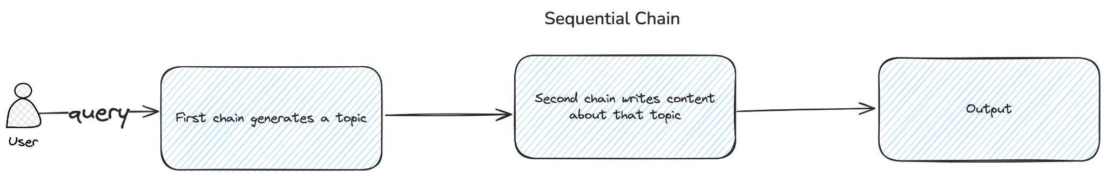
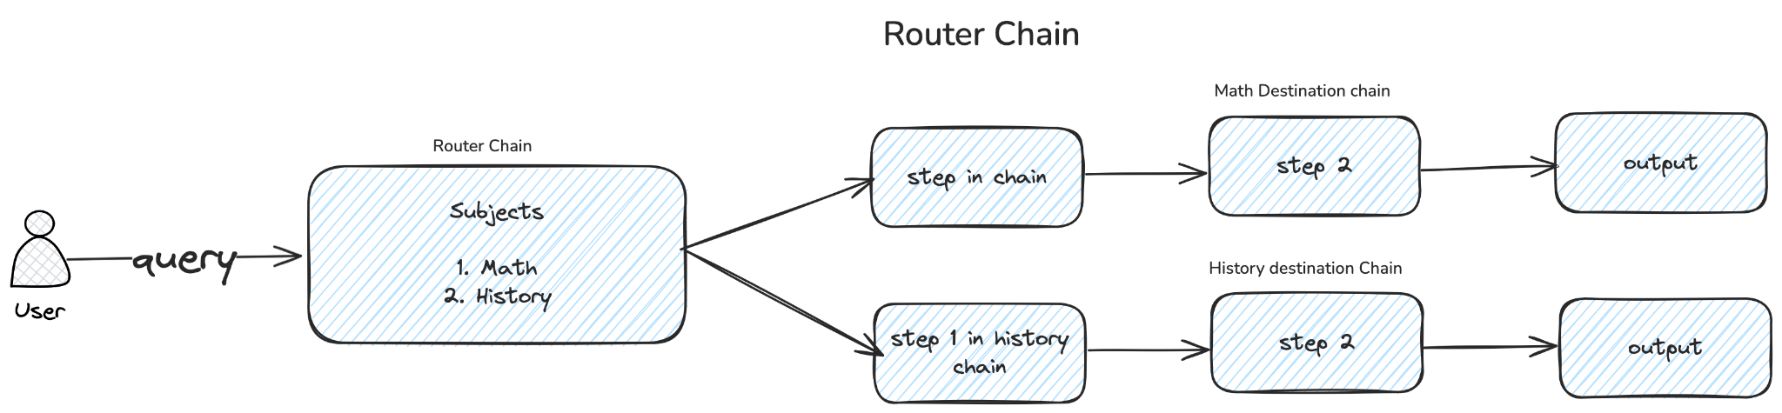
LangChain: Chains

Slide 15
LangChain: Chains - Router Chain
default_chain = LLMChain( # Make three of these! You need the math, history and default
llm=llm,
prompt=PromptTemplate(template="Answer the following question: {input}", input_variables=["input"])
)
# Define router prompt
router_template = """Given a question, select the appropriate destination:
1. math - For questions about mathematics and related topics
2. history - For questions about historical topics
User question: {input}
Destination:"""
router_prompt = PromptTemplate(template=router_template, input_variables=["input"])
router_chain = LLMRouterChain.from_llm(llm=llm, prompt=router_prompt)
chain = MultiPromptChain(
router_chain=router_chain,
destination_chains={"math": math_chain, "history": history_chain},
default_chain=default_chain
)

Slide 16
Output Parsers in LangChain
Output parsers convert LLM text responses into structured data
Common parsers:
StringOutputParser: Extracts plain text from LLM responses
CommaSeparatedListOutputParser: Parses lists
JsonOutputParser: Converts responses to JSON
PydanticOutputParser: Maps to Pydantic models
Parser chaining for complex transformations
Error handling and retry mechanisms
from langchain.schema.output_parser import StrOutputParser
# String output parser (most common)
string_parser = StrOutputParser()
chain = prompt | llm | string_parser

Slide 17
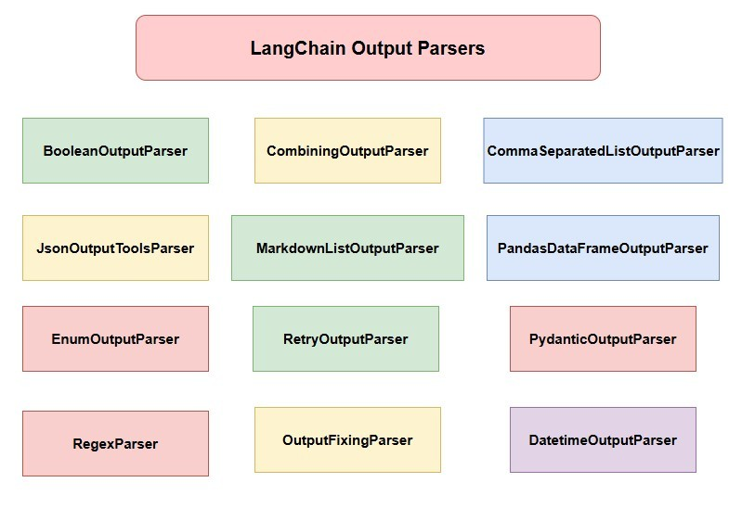
Output Parsers in LangChain

Slide 18
Output Parsers in LangChain
Output parsers convert LLM text responses into structured data
Common parsers:
StringOutputParser: Extracts plain text from LLM responses
CommaSeparatedListOutputParser: Parses lists
JsonOutputParser: Converts responses to JSON
PydanticOutputParser: Maps to Pydantic models
Parser chaining for complex transformations
Error handling and retry mechanisms
from langchain.output_parsers import CommaSeparatedListOutputParser
list_parser = CommaSeparatedListOutputParser()
list_chain = (
PromptTemplate.from_template("List 5 {topic} separated by commas:") |
llm |
list_parser
)
fruits = list_chain.invoke({"topic": "fruits"}) # Returns a Python list

Slide 19
Output Parsers in LangChain
Output parsers convert LLM text responses into structured data
Common parsers:
StringOutputParser: Extracts plain text from LLM responses
CommaSeparatedListOutputParser: Parses lists
JsonOutputParser: Converts responses to JSON
PydanticOutputParser: Maps to Pydantic models
Parser chaining for complex transformations
Error handling and retry mechanisms
from langchain_core.output_parsers import JsonOutputParser
# JSON parser
json_parser = JsonOutputParser()
json_chain = (
PromptTemplate.from_template("Generate JSON for {entity} with properties: {properties}") |
llm |
json_parser
)

Slide 20
Memory in LangChain
Memory components store conversation history and context
Use ConversationChain, to create a chain with memory.
Types of memory:
ConversationBufferMemory: Stores all interactions
ConversationSummaryMemory: Summarizes past interactions
ConversationBufferWindowMemory: Keeps last n interactions
Memory integration with chains and agents
Custom memory implementations for specific use cases
from langchain.memory import ConversationBufferMemory
from langchain.chains import ConversationChain
memory = ConversationBufferMemory()
conversation = ConversationChain(
llm=llm, memory=memory, verbose=True
)
conversation.predict(input="Hi, my name is Bob")
conversation.predict(input="What's my name?") # Should remember "Bob"

Slide 21
Question Answering with LangChain
QA systems combine:
Document retrieval (vector stores)
Context augmentation
-> Retrieval Augmented Generation (RAG)
Types of QA chains:
RetrievalQA: Simple document → answer
ConversationalRetrievalChain: Maintains conversation history
Handling sources and citations
Optimizing for accuracy and relevance
from langchain.chains import RetrievalQA
from langchain.vectorstores import Chroma
from langchain.embeddings import OpenAIEmbeddings
# Create vector store from documents
embeddings = OpenAIEmbeddings()
vectorstore = Chroma.from_documents(documents, embeddings)
# Create QA chain
qa_chain = RetrievalQA.from_chain_type(
llm=llm,
chain_type="stuff",
retriever=vectorstore.as_retriever()
)
# Ask a question
qa_chain.run("What is the capital of France?")

Slide 22
Introduction to React Agents
ReAct = Reasoning + Acting
Agents combine:
LLM as the reasoning engine
Tools for interacting with external systems
Planning and execution loops
Agent types in LangChain:
ReAct: Reasoning and Acting
Plan-and-Execute: Planning followed by execution
ReflexionAgent: Self-reflection capabilities
When to use agents vs. chains:
Many cases can be covered by both
No exact answer
Chains = simple, agents = complex
from langchain.agents import load_tools, initialize_agent, AgentType
from langchain.llms import OpenAI
# Load tools for the agent to use
tools = load_tools(["serpapi", "llm-math"], llm=llm)
# Initialize ReAct agent
agent = initialize_agent(
tools,
llm,
agent=AgentType.ZERO_SHOT_REACT_DESCRIPTION,
verbose=True
)
agent.run("What was the high temperature in SF yesterday? What is that number raised to the .023 power?")

Slide 23
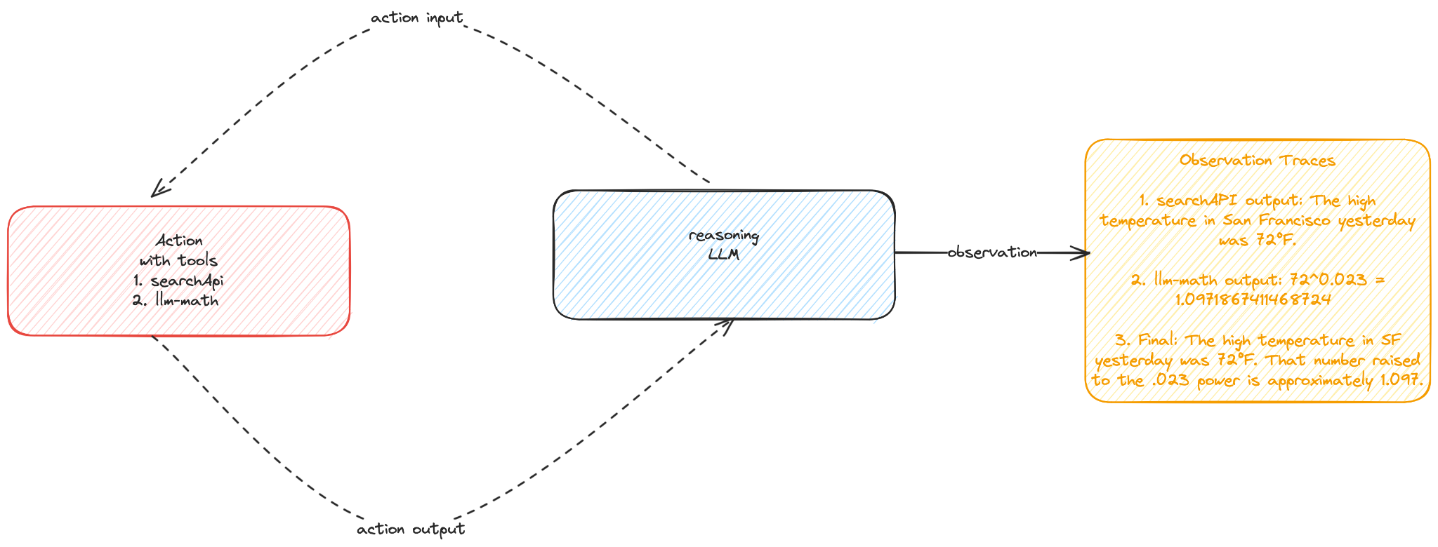
Agent Reasoning Process
The ReAct framework:
Thought: Agent's internal reasoning process
Action: Tool selection based on reasoning
Observation: Results from tool execution
Final Answer: Conclusion after reasoning loop

Slide 24
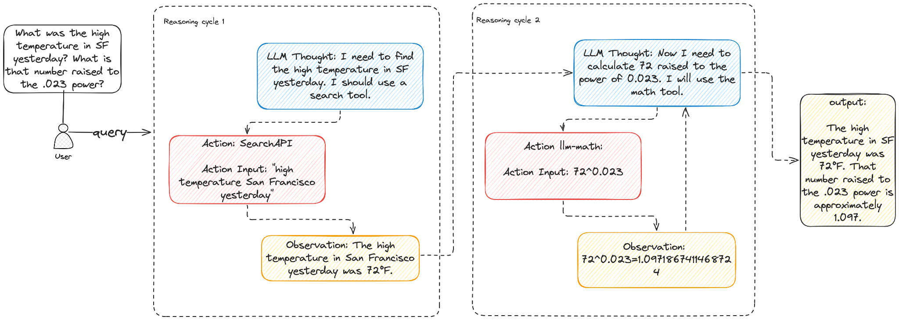
Agent Reasoning Process

Slide 25
Building Custom Tools for Agents
Tools are functions that agents can use to interact with the world
Creating custom tools:
Define tool functionality
Create descriptive docstrings
Implement error handling
Tool categories:
Information retrieval
Computation
API interaction
Database operations
from langchain.agents import Tool
# Create a custom database tool
def query_database(query):
"""Run SQL query on the customer database"""
# Database connection code here
return f"Query results: {results}"
db_tool = Tool(
name="CustomerDatabase",
description="Query customer information from the database. Input should be a SQL query.",
func=query_database
)
# Add tools to agent
agent = initialize_agent([db_tool], llm, agent=AgentType.ZERO_SHOT_REACT_DESCRIPTION)

Slide 26
Agent Types and Selection
Different agent architectures for different tasks:
ZERO_SHOT_REACT_DESCRIPTION: No examples, good for general tasks
CONVERSATIONAL_REACT_DESCRIPTION: Optimized for dialogue
STRUCTURED_CHAT_ZERO_SHOT_REACT_DESCRIPTION: For structured outputs
Selecting the right agent type:
Task complexity
Interaction pattern
Output structure requirements
Custom agent prompts for specialized behaviors

Slide 27
Stateful Agents with Memory
from langchain.memory import ConversationSummaryMemory
from langchain.agents import AgentExecutor, create_react_agent
# Memory with summarization to handle longer conversations
memory = ConversationSummaryMemory(
llm=llm,
memory_key="chat_history",
return_messages=True
)
agent_executor = AgentExecutor.from_agent_and_tools(
agent=create_react_agent(llm, tools, prompt),
tools=tools,
memory=memory,
verbose=True
)
# First interaction
agent_executor.run("My name is Alice")
# Later interaction - agent should remember the name
agent_executor.run("What's my name?")
Maintaining context across interactions:
Short-term memory (conversation history)
Long-term memory (vector stores)
Memory types for agents:
ConversationBufferMemory
ConversationSummaryMemory
VectorStoreMemory
Think about:
Implementing persistent storage for agent state
Handling context window limitations

Slide 28
Advanced Agent Patterns (more tomorrow!)
Multi-agent systems:
Specialized agents for different tasks
Agent collaboration and communication
Self-critique and reflection:
Agents evaluating their own performance
Iterative improvement of responses
Planning agents:
Breaking complex tasks into subtasks
Managing execution of subtask sequence
# Example of a planning agent
from langchain.agents import create_plan_and_execute_agent
# Create a planning agent
planning_agent = create_plan_and_execute_agent(
llm=llm,
tools=tools,
verbose=True
)
# Complex task requiring planning
result = planning_agent.run(
"Create a comprehensive market analysis for electric vehicles. " +
"Include current market leaders, growth projections, and regulatory environment."
)

Slide 29
Assignment 3
Build an agentic system to write a short report about one of the chosen topics you learned about in this course (CI/CD, MLops, APIs, Gradio, or anything of your choice).
Report (15 points total):
  Your software should be able to produce a report with 1000 words (+- 50 words). (5 points)
  The report should be factually correct and have a clear structure (introduction, main text, conclusion or similar), marked with clear titles. (5 points)
  The topic of the report should be related to the course. (5 points)
Agentic system (65 points total):
The prompts should be clear and follow the best prompting practices (15 points)
The model can use either a simple single call to an LLM (5 points) or a complex agentic system (up to 50 points). Be creative here. You can use LangChain or LangGraph, you can create multiple agents (one for writing, one for research, fact checking etc…). Find some examples and ideas online. Let the agent use tools. For example web search or RAG to find information on the given topic. You can use tools to check for the length of the report (remember that LLMs are not good at counting, but a python script can be very efficient).
System diagram (10 points total):
Draw a diagram of your agentic workflow. (Note that some of the libraries like LangGraph can do this automatically. It doesnt matter how you do it, as long as you create some form of a diagram that shows how your system works)
User interface (10 points total):
Create an interface in Gradio and deploy to GCP to be part of your OpenAPI project. Be creative. Choose your own things you want to display and control. For example you can let the user input the topic or control the temperature of the models. You can have the app display the report on screen or save it to a txt file (or both). (10 points)
(Optional) If you are feeling very creative, you can add a human in the loop component, where a human can edit the “working version” of the document before submitting it for future review to the agent. You can also let the user input additional prompts to modify how the agent behaves on the go (bonus 10 points)
Since some of you might create interactive apps, please submit the code; the AI generated report together (the report can be a simple .txt file or whatever similar); and a URL to your OpenAPI project on GCP. In addition, please submit an image file showing the diagram of your agentic system. If your app allows to use different settings, please also include instructions (it can be in the app or in a readme.md or similar file with the settings of your app that you used to produce the graded report). If there are any other comments/remarks/explanations you would like to make to accompany your submission, also put them into the readme file (optional).

